Slide 1
Microservices and DevOps
DevOps and Container Technology
Seminar 3 Exercises
Henrik Bærbak Christensen

Slide 2
Scaling

Slide 3
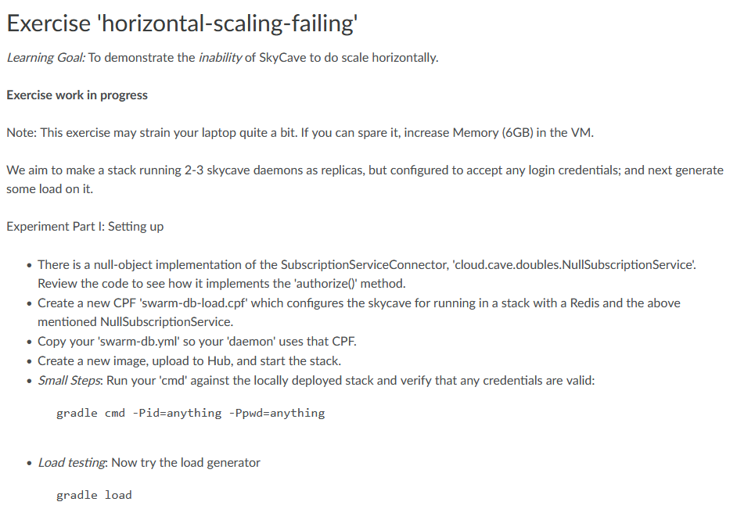
Scaling Exercise 1
Solve Iteration 5’s ‘horizontal-scaling-failing’ exercise

Slide 4
Scaling Exercise 2
Have a go at the ‘session-database’ exercise.

Slide 5
CI and Pipelines

Slide 6
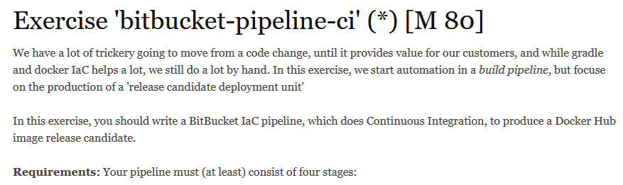
CI Exercise 1
Start on
Advice:
Take small steps (I had 45 failed commits ☹)
Or maybe have a look at their ‘try locally’ guide (?)

Slide 7
Exam

Slide 8
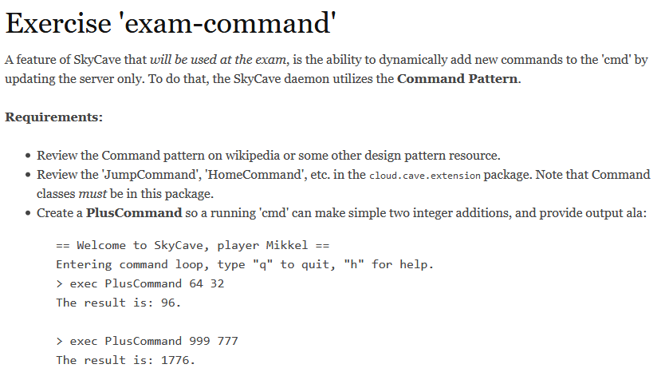
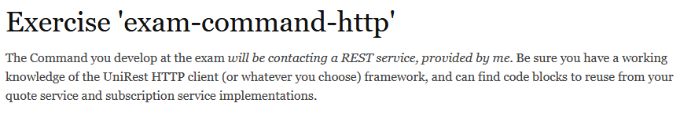
Exam Exercises
My dryrun of the exam exercise showed that I spend quite some time in the ‘use command pattern’ part. So…

Slide 9
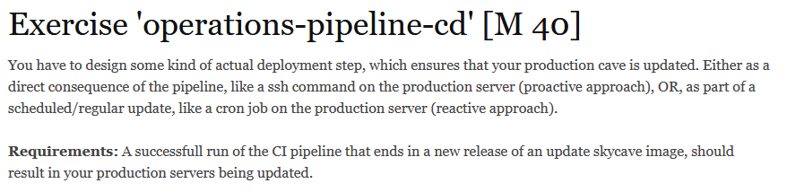
Alternative
Look into CD instead…

